Slide 1
Travel Plan Booking System
Presented by-
Senghani Riya(240160510045)

Slide 2
Existing System
In the existing system, all work is performed manually.
Customers must visit the travel agency in person to inquire about travel packages, book tickets, make payments, and collect receipts.
Tour packages are recorded in notebooks, and customer details are managed using physical registers.
Advertisements are mainly published in local newspapers or promoted within local markets.
Travel services are limited to a specific area and serve only a limited number of customers.
Existing System Problems
The manual system is time-consuming and inefficient.
Customers face inconvenience by having to visit the office for every service.
Managing customer records, package details, and payment receipts in physical registers increases the chances of data loss or errors.
Marketing reach is limited due to traditional advertising methods.
Additionally, the travel service coverage is restricted to a small area, limiting the business's growth and customer base.

Slide 3
New System
The new system is a web-based application designed to automate and improve the travel booking process.
It allows customers to search for available travel packages online, view detailed package information, and make bookings from anywhere.
The system also includes online payment functionality, enabling secure transactions without the need for in-person visits.
Customers can generate and view various reports, such as booking history and payment receipts.
Additionally, the system provides a facility for booking cancellations, where 15% of the amount is deducted as a cancellation charge, and the remaining balance is refunded.

Slide 4
Need for a New System
It eliminates the need for customers to visit the travel office physically, saving time and increasing convenience.
With online search and booking features, the system enhances customer experience and accessibility.
Automated data management ensures accuracy and reduces the risk of lost or misplaced records.
Online payments and cancellation policies also streamline operations and make the service more customer-friendly and professional.

Slide 5
Services Provided by New System
View Package
Search Package
Package Booking
Cancel Booking
Online Payment

Slide 6
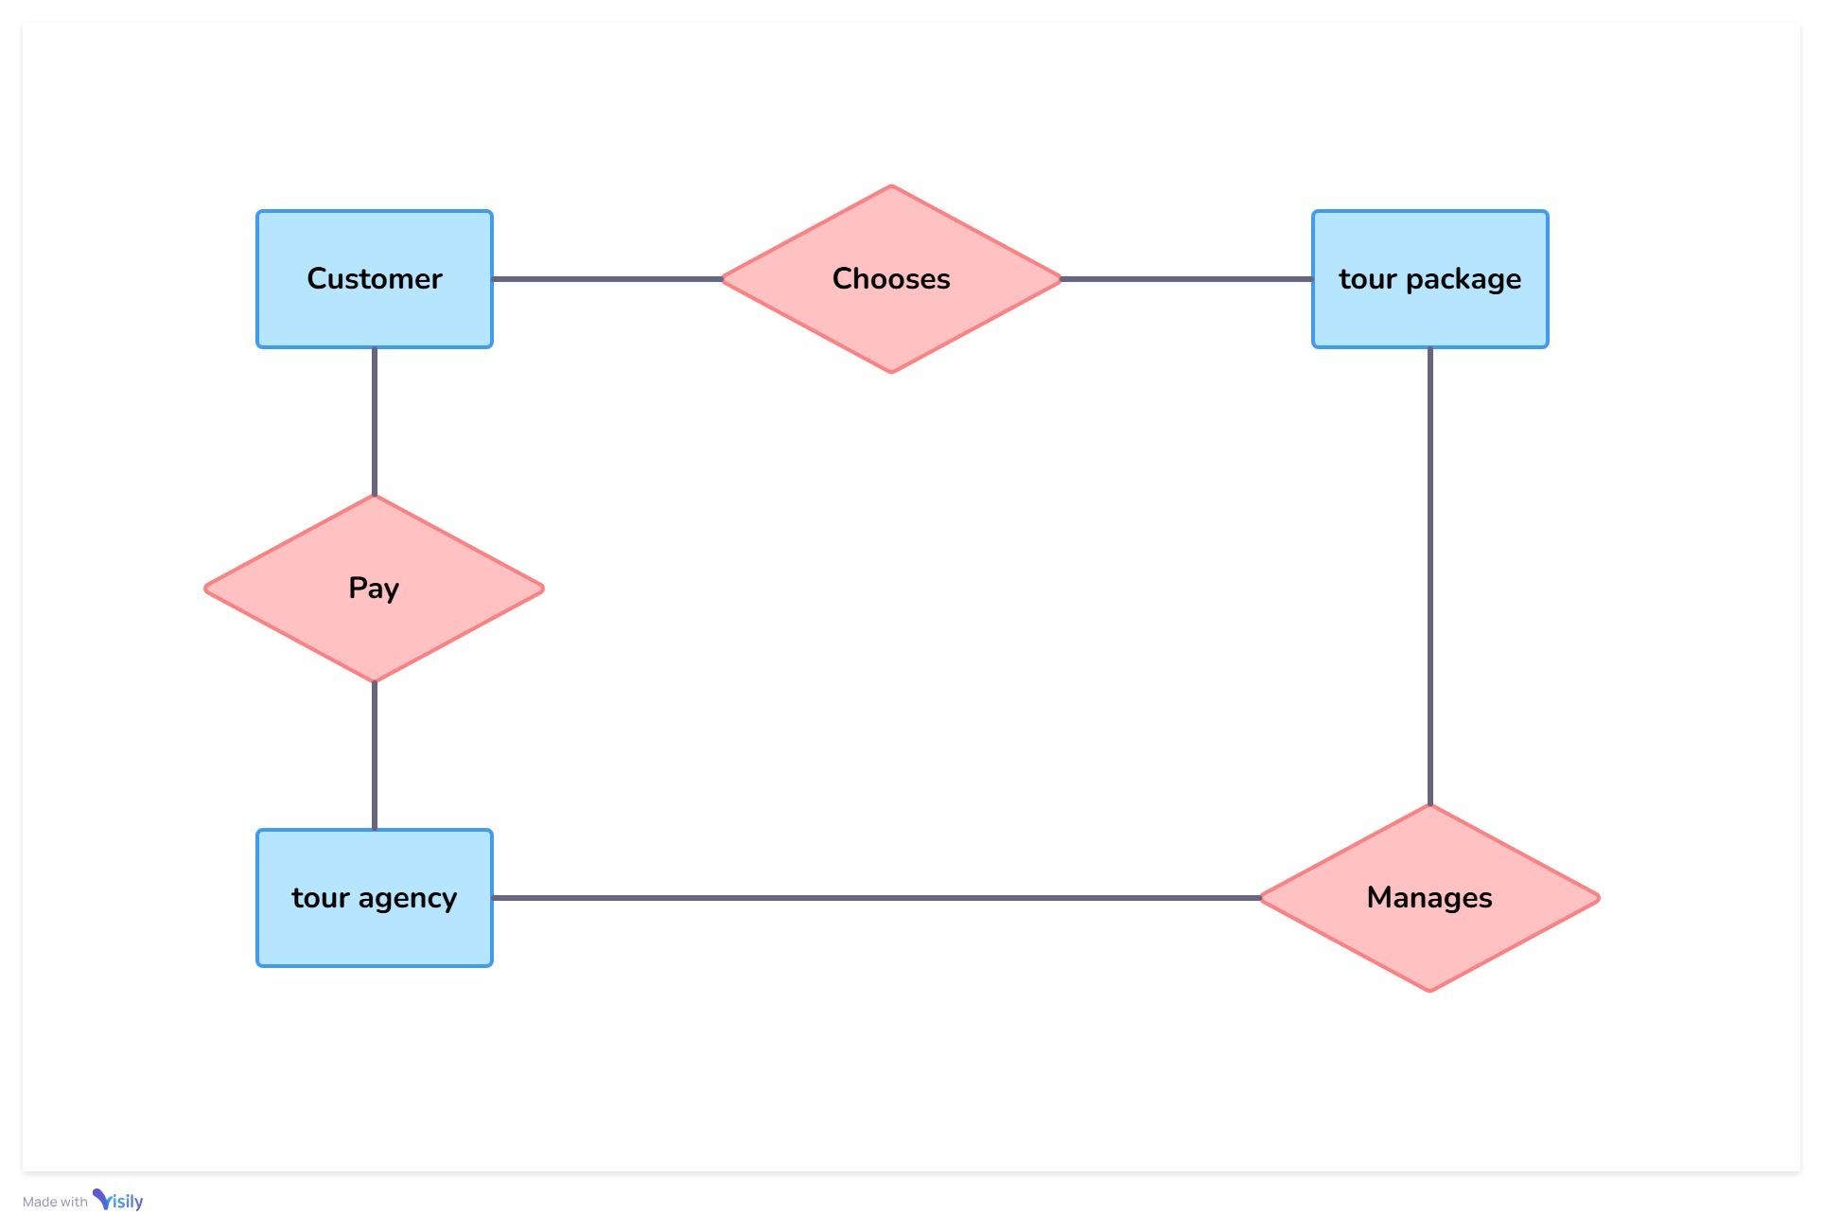
Entity Relationship Diagram

Slide 7
Use case
Admin can login , manage user , receive package from travel Agent, manage ticket booking, manage payment and view feedback.
Customer can view package , search package , book package , cancel package , make payment and give feedback.
Travel Agent can manage tour , manage tour package cost , manage bus travel and give package to the admin.

Slide 8
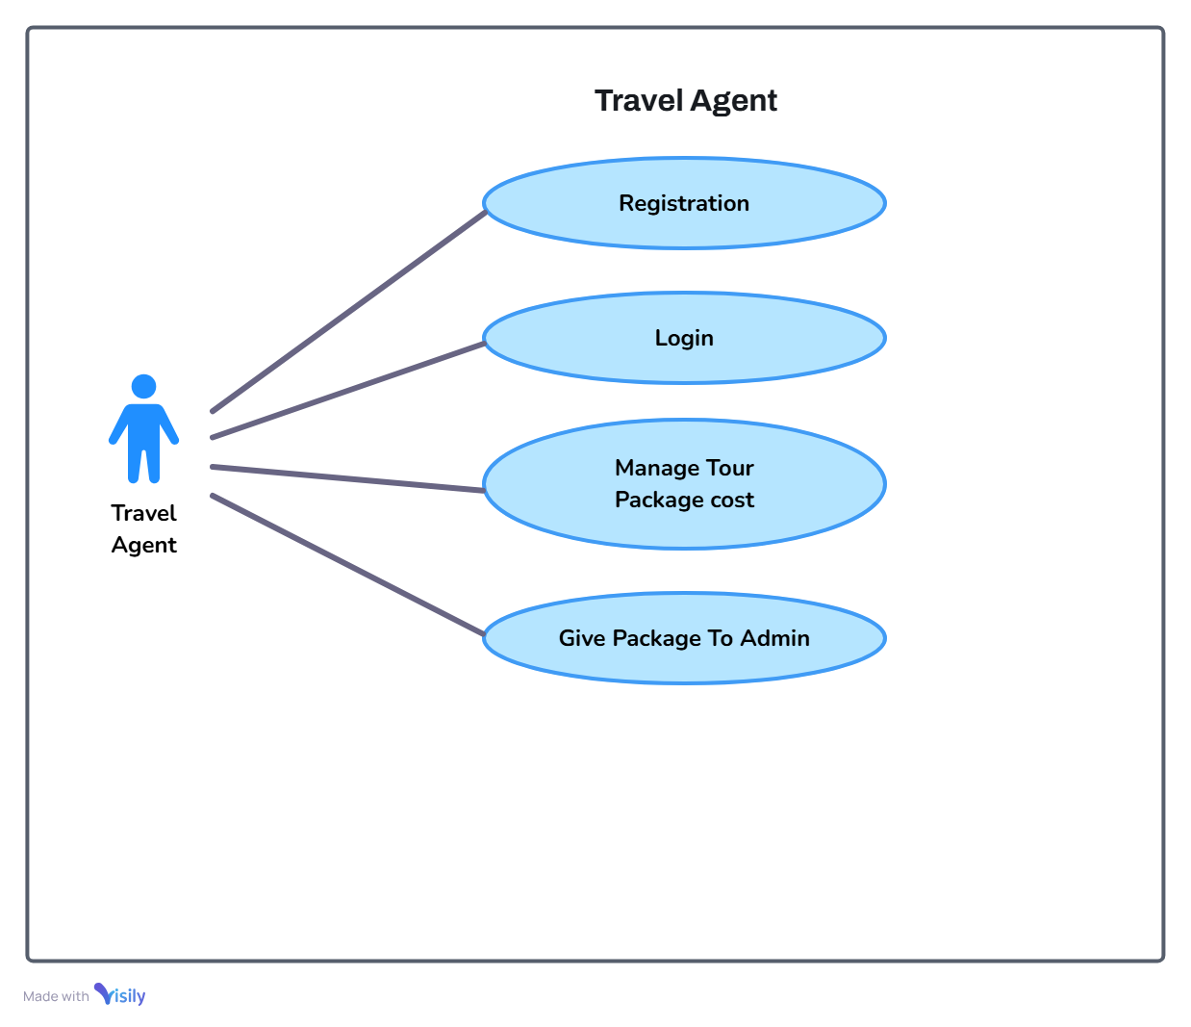
Use Case Diagram : Travel Agent

Slide 9
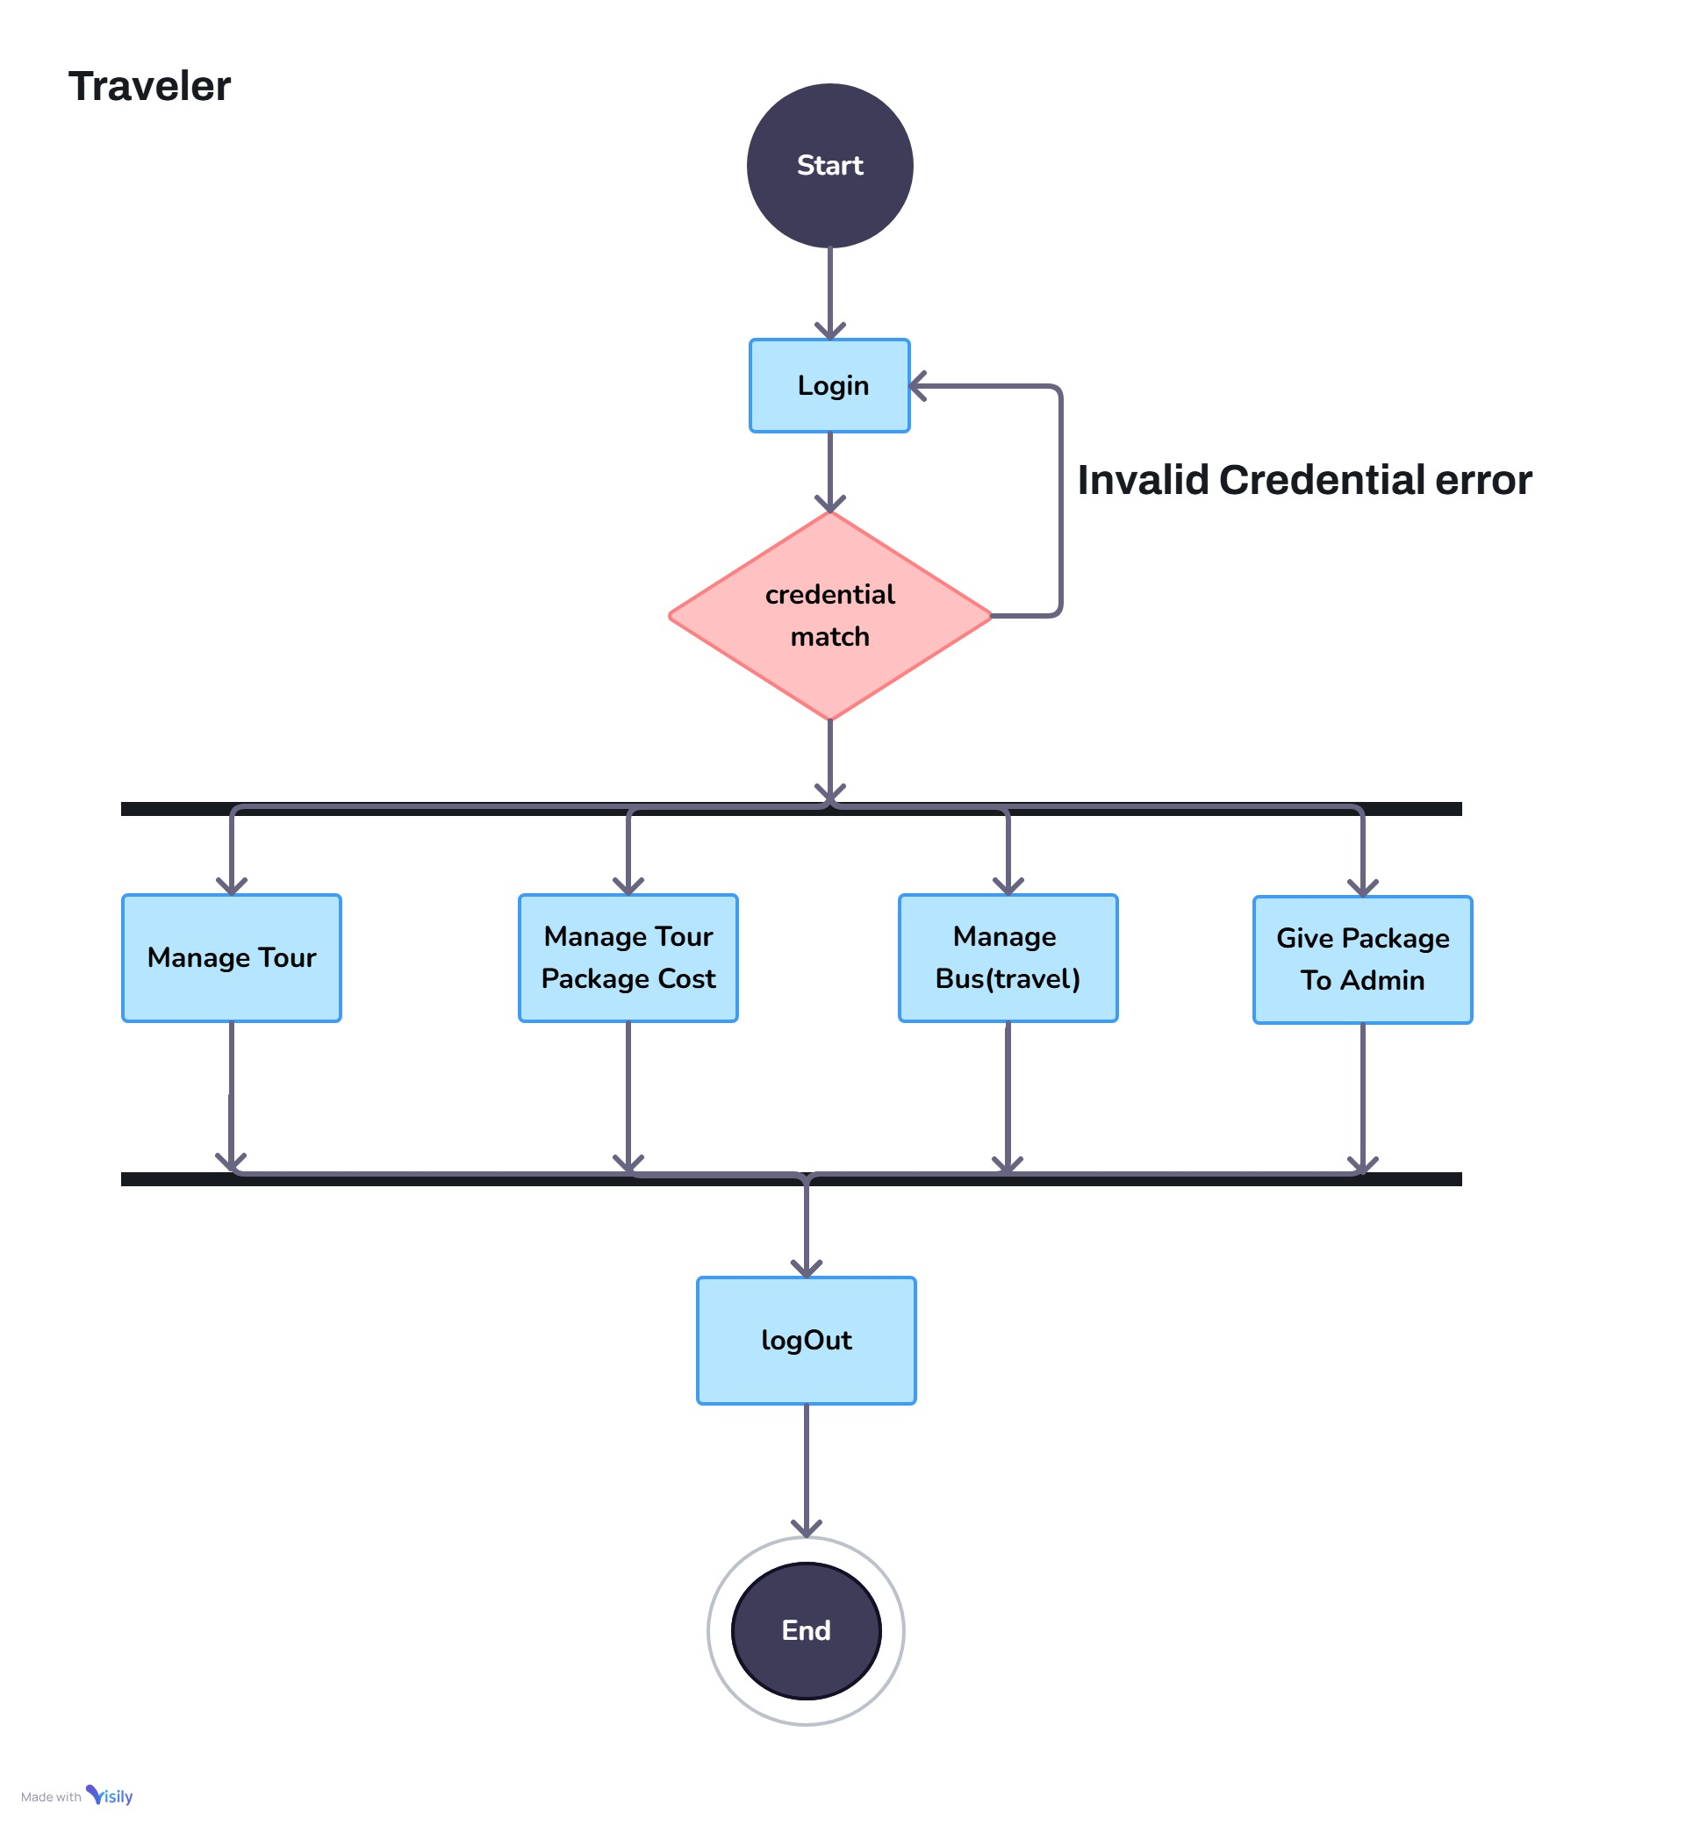
Travel Agent
Activity Diagram : Travel Agent

Slide 10
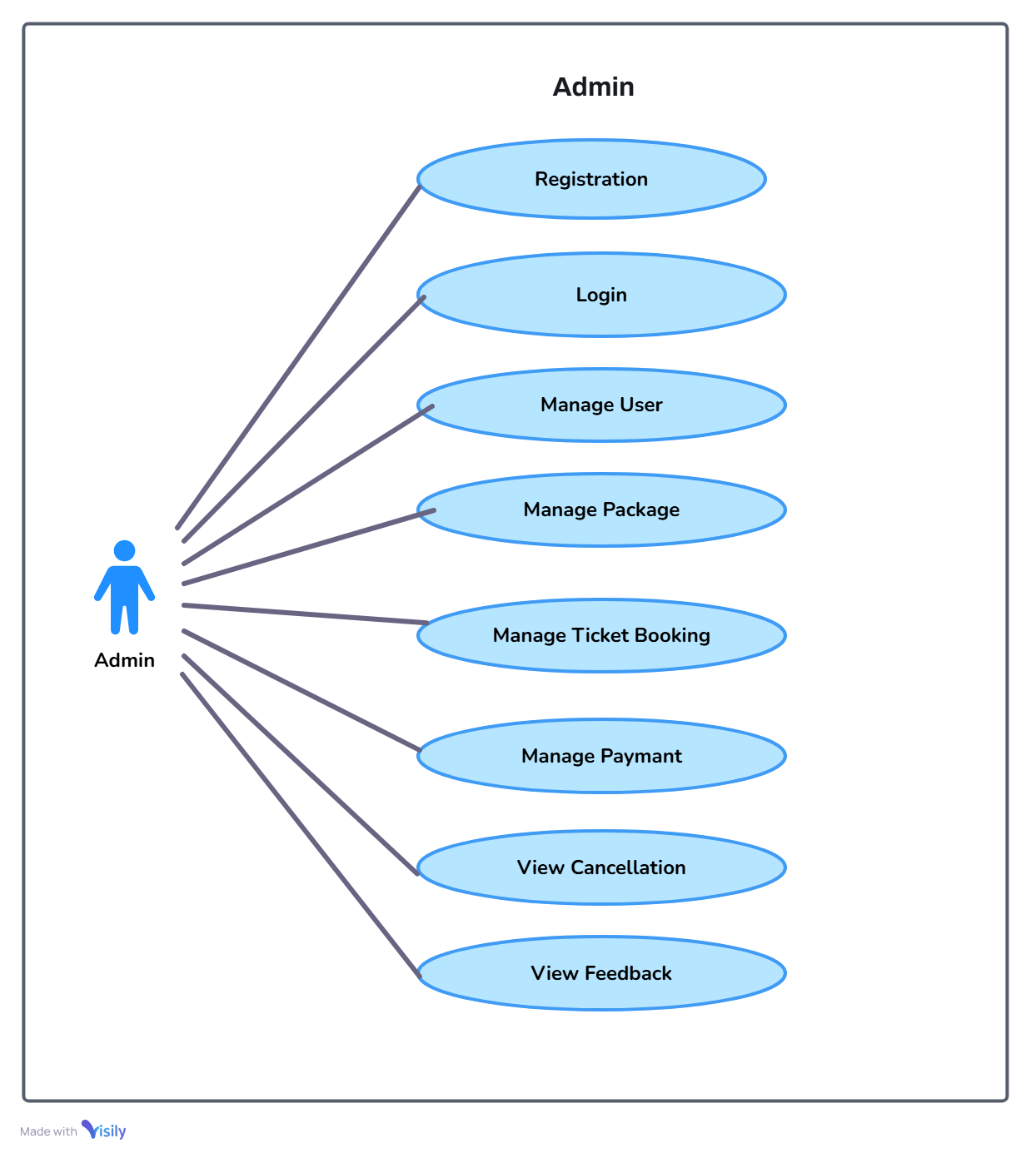
Use Case Diagram : Admin

Slide 11
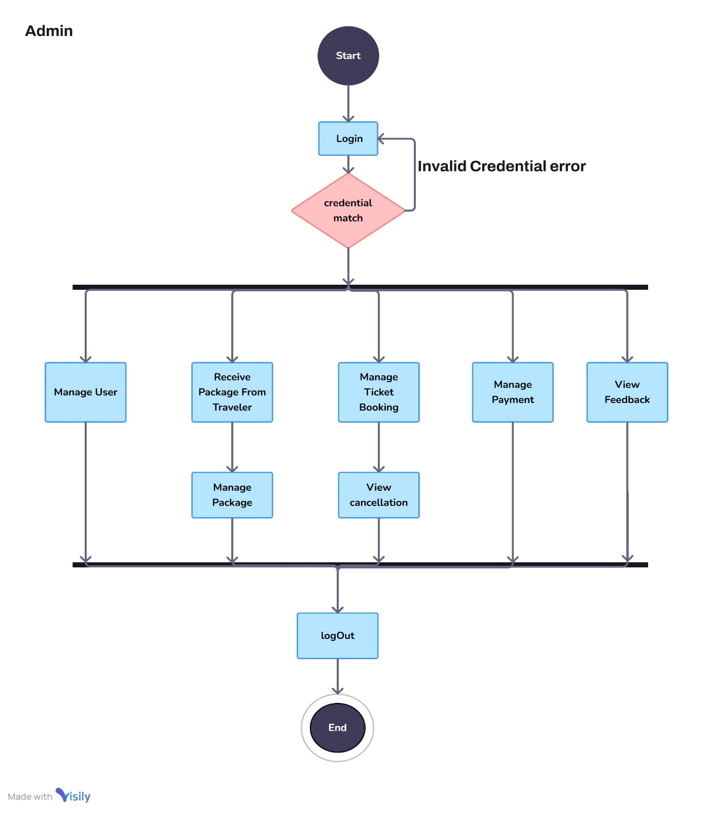
Activity Diagram : Admin

Slide 12
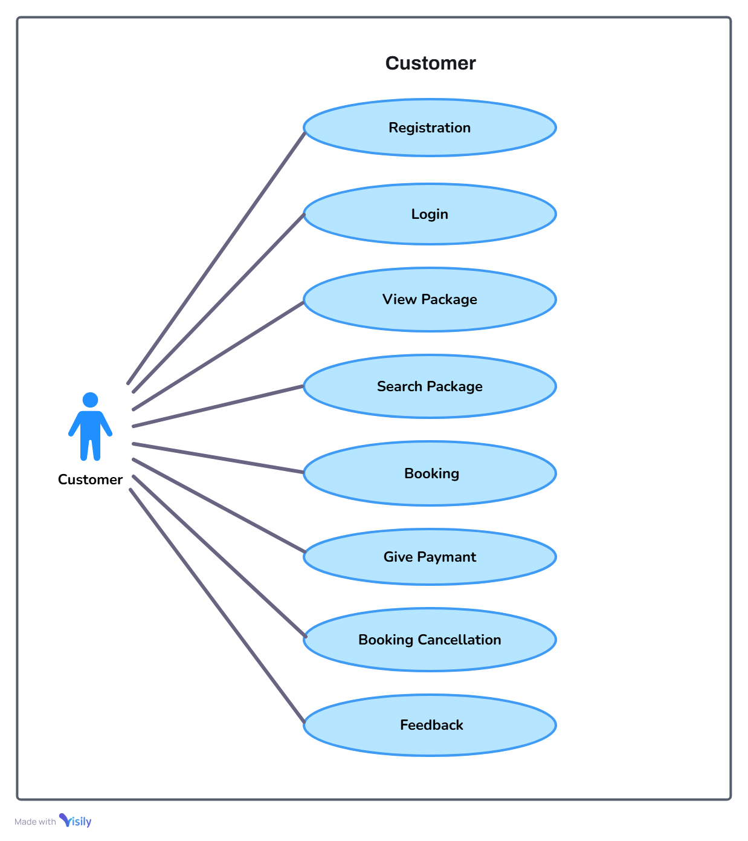
Use Case Diagram : Customer

Slide 13
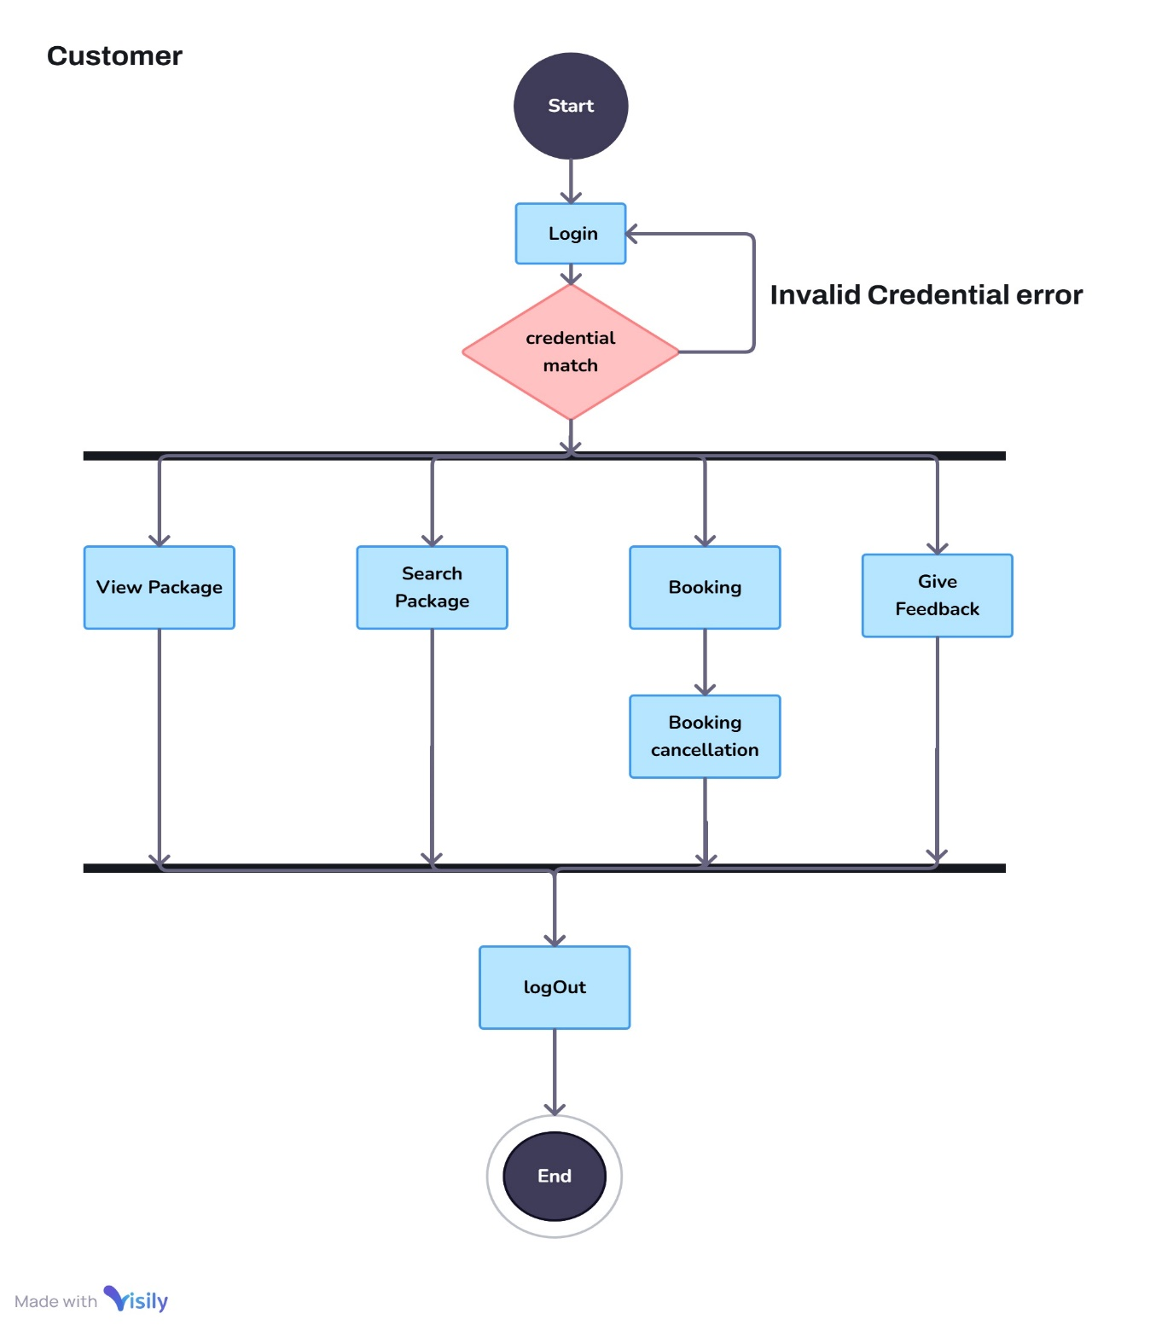
Activity Diagram : Customer

Slide 14
Data Dictionary
Travel_agent(Id, Name)
Admin(UserName, Password)
Customer(UserName, Password, Address)
Package(Package_id, Package_name, Package_price)
Ticket_Booking(Date, Price, Package_id (Foreign Key))
Payment(Mode,UserName (likely referencing either Customer or Admin), Date, Can_seat)
Ticket_Cancellation(Amount, Date (assumed, based on relation to Booking or Payment))
Feedback(Username, Feedback (Text/Comment))

Slide 15
Thank You

